Slide 1


Nutan Maharashtra Vidya Prasarak Mandal’s NUTAN COLLEGE OF ENGINEERING AND RESEARCH Under Administrative Support of Pimpri Chinchwad Education Trust ISO 21001:2018 EOMS Certified
Review -IV
Presentation on
AI FOR LEGAL CASE OUTCOME PREDICTION
By
Amay Lohar (B14)
Nikhil Raghuwanshi (B36)
Shital Kalekar (B62)
Shraddha Dhanwate (B76)
Under the guidance of
Prof. Priyanka Patil
Department of CSE-Artificial Intelligence

Slide 2
Nutan Maharashtra Vidya Prasarak Mandal’s NUTAN COLLEGE OF ENGINEERING AND RESEARCH Under Administrative Support of Pimpri Chinchwad Education Trust ISO 21001:2018 EOMS Certified
Project Phase- IV
Introduction
The Indian judicial system processes millions of cases annually, documented in lengthy, unstructured PDFs.
Manual legal research and outcome prediction are highly time-consuming and cognitively demanding.
Our Solution: A production-grade, end-to-end Legal AI Engine designed to read complex court judgments, automatically translate outdated laws, and predict appellate outcomes.
Core Technology: Advanced domain-specific Transformers (InLegalBERT), augmented by Dynamic Statutory Translation and Explainable AI (SHAP).

Slide 3
Nutan Maharashtra Vidya Prasarak Mandal’s NUTAN COLLEGE OF ENGINEERING AND RESEARCH Under Administrative Support of Pimpri Chinchwad Education Trust ISO 21001:2018 EOMS Certified
Review - IV
Problem Statement
The legal system suffers from a massive backlog, with judgments spanning hundreds of unstructured pages. Applying standard AI introduces three major roadblocks:
1. Token Limits & Data Leakage: Standard models crash on documents over 512 tokens, or they accidentally read the judge's final verdict while trying to predict it (data leakage).
2. Statutory Transitions: India's shift from the Indian Penal Code (IPC) to the Bharatiya Nyaya Sanhita (BNS) makes legacy AI models instantly obsolete, as they don't understand the new laws.
3. The "Black Box" Trust Issue: Legal professionals cannot trust an AI that predicts "Dismissed" without providing clear, verifiable legal reasoning.

Slide 4
Nutan Maharashtra Vidya Prasarak Mandal’s NUTAN COLLEGE OF ENGINEERING AND RESEARCH Under Administrative Support of Pimpri Chinchwad Education Trust ISO 21001:2018 EOMS Certified
Review - IV
Problem Solution
Structure-Aware Chunking: Engineered a custom Regex pipeline to specifically isolate 'Facts' and 'Arguments', bypassing token limits and preventing data leakage.
Dynamic JSON Middleware: Built an automated translation layer that seamlessly maps historical IPC sections to modern BNS equivalents before AI inference.
Dual-Inference Pipeline: Utilizes InLegalBERT to instantly predict both Jurisdiction and Appellate Outcome with 85.2% accuracy.
NER-Filtered Explainability: Integrated SHAP with spaCy (NER) to highlight only critical legal statutes and entities, ensuring zero-noise transparency for lawyers.

Slide 5
Nutan Maharashtra Vidya Prasarak Mandal’s NUTAN COLLEGE OF ENGINEERING AND RESEARCH Under Administrative Support of Pimpri Chinchwad Education Trust ISO 21001:2018 EOMS Certified
Review - IV
Objectives
Objective 1: Curate a real-world corpus of Indian judicial data from the Supreme Court and High Courts.
Objective 2: Engineer a robust NLP pipeline using PyMuPDF and Structure-Aware Chunking to extract core case facts.
Objective 3: Implement a dynamic translation layer to bridge the gap between historical IPC laws and the new BNS framework.
Objective 4: Train and deploy a high-accuracy InLegalBERT transformer model for binary outcome prediction.
Objective 5: Develop a fully secure, cloud-based SaaS dashboard (Supabase + Streamlit) with transparent AI reasoning.

Slide 6
Nutan Maharashtra Vidya Prasarak Mandal’s NUTAN COLLEGE OF ENGINEERING AND RESEARCH Under Administrative Support of Pimpri Chinchwad Education Trust ISO 21001:2018 EOMS Certified
Review - IV
Methodology/ Workflow
Data Extraction: Extracted raw text from legal PDFs using PyMuPDF.
Dynamic Translation: Passed text through a JSON/Regex middleware to translate IPC references to BNS.
Structure-Aware Chunking: Isolated strictly 'Facts' and 'Arguments' to feed the AI pure, unbiased context.
InLegalBERT Execution: Processed cleaned chunks through fine-tuned InLegalBERT for Jurisdiction and Outcome prediction.
Explainable AI (XAI): Filtered SHAP outputs through spaCy NER to generate visual heatmaps of the exact decision-driving words.
Secure SaaS Deployment: Wrapped the entire pipeline in a Streamlit frontend with a Supabase PostgreSQL backend for encrypted lawyer authentication and case history tracking.

Slide 7
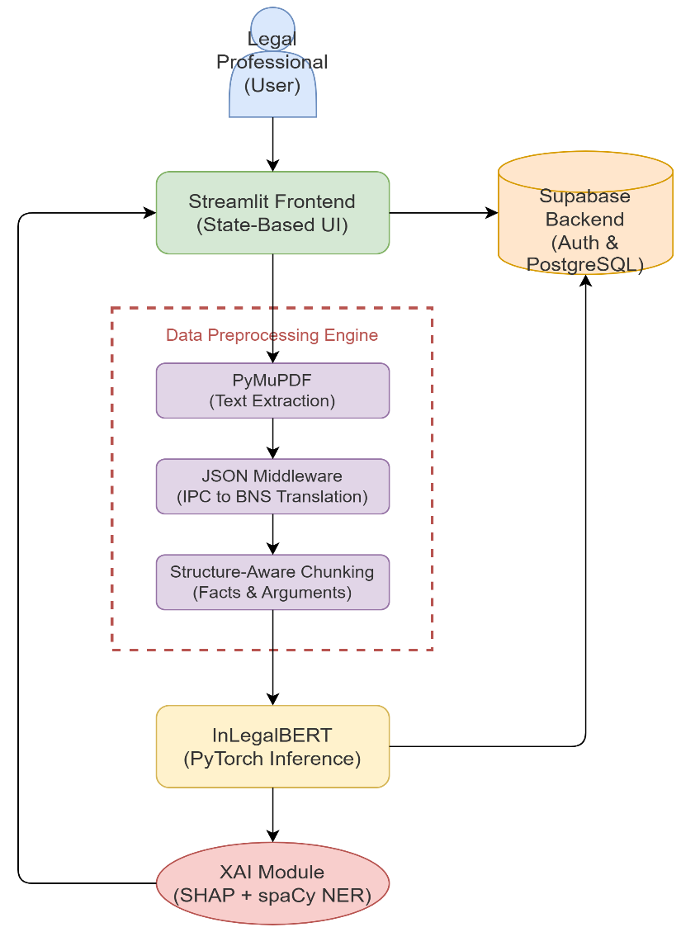
Nutan Maharashtra Vidya Prasarak Mandal’s NUTAN COLLEGE OF ENGINEERING AND RESEARCH Under Administrative Support of Pimpri Chinchwad Education Trust ISO 21001:2018 EOMS Certified
Review - IV
System Architecture

Slide 8
Nutan Maharashtra Vidya Prasarak Mandal’s NUTAN COLLEGE OF ENGINEERING AND RESEARCH Under Administrative Support of Pimpri Chinchwad Education Trust ISO 21001:2018 EOMS Certified
Review - IV
Literature Survey
Sr.No | Title | Year | Study Type/ Approach | Objective | Limitations
1 | The Case for AI- Powered Legal Aid | 2023 | Analytical and qualitative study examining the role of AI in enhancing access to justice. | To analyze how AI-powered legal aid tools like MyOpenCourt can improve access to justice legal processes. | Limited empirical validation, privacy and security risks, digital divide issues, and concerns over unauthorized practice of law.
2 | AI-powered decisionmaking in facilitating insurance claim dispute resolution | 2023 | Analytical and conceptual study using comparative analysis to evaluate AI’s role in transforming the legal sector. | To explore how AI applications can enhance judicial efficiency, accuracy in the legal system. | Challenges include ethical issues, lack of legal framework, data privacy concerns, and limited technological infrastructure.
3 | Predictive Modelling in Legal DecisionMaking: Leveraging Machine Learning for Forecasting Legal Outcomes | 2024 | Descriptive and analytical study examining the integration of AI in the legal sector. | To highlight how AI enhances efficiency, transparency, and decision-making in law. | Ethical concerns, data bias, lack of regulation, and dependency on technology.
4 | Predictive Justice in Indian Courts: Machine Learning Approaches to Case Outcome Forecasting | 2024 | Sophisticated, multi-layered machine learning,Deep Neural Networks, SVM,NLP predictive legal analytics framework tailored to the Indian judicial system. | Develop a model for predicting judicial outcomes,analyze factors influencing judicial decisionmaking in the Indian context | Limited historical data availability, challenges in representing contextual nuance, and potential algorithmic biases.

Slide 9
Nutan Maharashtra Vidya Prasarak Mandal’s NUTAN COLLEGE OF ENGINEERING AND RESEARCH Under Administrative Support of Pimpri Chinchwad Education Trust ISO 21001:2018 EOMS Certified
Review - IV
5 | Ai in legal analytics : balancing efficiency, accuracy, and ethics in contract and predictive analysis . | 2023 | Analytical essay/review discussing the role, benefits, challenges of AI in Legal Analytics, focusing on contract and predictive analysis. | Analyze how AI revolutionized the legal system, discussing shortcomings of AI systems, recommending their integration into legal work. | Challenges with accuracy and reliability , bias and fairness from training data , issues of professional integrity/technological competence , and data privacy concerns.
6 | Artificial intelligence as evidence | 2024 | Analysis of the legal and technical issues governing the admissibility of Artificial Intelligence (AI) evidence in civil and criminal trials under the Federal Rules of Evidence. | Provide a practical overview and a systematic framework for lawyers and judges to evaluate the validity and reliability of AI evidence | Bias (in data, programming, and human interpretation), lack of robust testing for validity and reliability, function creep, lack of transparency/explainability, lack of accountability, and lack of resilience
7 | Agentic AI-Driven Process Optimization and Cost Reduction in Legal Services Using DeepSeek | 2025 | Development and empirical evaluation of LegalMind, a novel agentic AI framework leveraging the DeepSeek R1 LLM for intelligent legal process automation cost reduction. | Design implement a transformer-based agentic AI framework to perform human-like legal reasoning, enable continuous learning, | Struggles with complex legal reasoning and ethical dilemmas, data sensitivity and privacy concerns, challenges with cross-jurisdictional adaptability, and high computational resource requirements for smaller firms.
8 | Outcome Prediction in the Practice of Law | 2020 | Analytical article examining the traditional tools and new data science/AI approaches | Examine traditional legal prediction tools and their limitations, describe how new data-science enhance legal outcome prediction. | Lack of key empirical data (e.g., settlement data and detailed facts in published opinions) and extra-legal considerations make accurate prediction difficult, even for AI.

Slide 10
Nutan Maharashtra Vidya Prasarak Mandal’s NUTAN COLLEGE OF ENGINEERING AND RESEARCH Under Administrative Support of Pimpri Chinchwad Education Trust ISO 21001:2018 EOMS Certified
Review - IV
9 | AI for legal justice | 2025 | Analytical review discussing the need for and the various components of a comprehensive ethical framework for the utilization of ai in the judicial | Propose a comprehensive, multi-layered ethical framework for the use of AI in the judicial system that safeguards the rule of law, constitutional values. | The fundamental nature of the study is a theoretical proposal of an ethical framework, so it does not contain empirical/technical limitations, but addresses the risks inherent to AI in law
10 | Legal Judgment Prediction (LJP) Amid the Advent of Autonomous AI Legal Reasoning | 2023 | Analytical review investigating the risks and benefits of Algorithmic Decision Systems at the intersection of AI proposing a regulatory framework. | Critically examine ADS risks and benefits to propose a comprehensive regulatory and ethical framework. | Algorithmic opacity, difficulty mitigating bias, and challenges from the dynamic nature of predictive systems
11 | Legal & Ethical Implications of Predictive Digital Techniques in the Judicial Criminal Proceedings | 2025 | Analytical review focused on identifying and mitigating the legal and ethical challenges associated with the adoption of AI in the justice system to ensure compliance with the Rule of Law. | Analyze the legal, ethical, and societal challenges posed by AI in the justice system (e.g., judicial and public administration) and propose solutions that respect the fundamental rights and the Rule of Law. | Algorithmic bias/fairness, lack of transparency (black box), issues of accountability, potential for "robot judges" or a status quo effect (mechanical application of law), and concerns about the reliability of AI outputs.
12 | Artificial intelligence in the courtroom : The delivery of JUSTICE IN THE AGE OF MACHINE LEARNING | 2023 | a novel 'Predictive Justice Score' (PJS) metric to measure the predictive capacity of machine learning (ML) models in judicial decision-making, along with a discussion of ethical and legal concerns. | Propose a new metric, the Predictive Justice Score (PJS), for evaluating the capability of ML algorithms to predict judicial decisions and discuss the related legal and ethical challenges. | Lack of a definitive 'Ground Truth' in judicial decisions for comparison, susceptibility to data bias and algorithmic opacity, and the challenge of incorporating the nuance of constitutional and legal interpretation into quantitative metrics like the PJS.

Slide 11
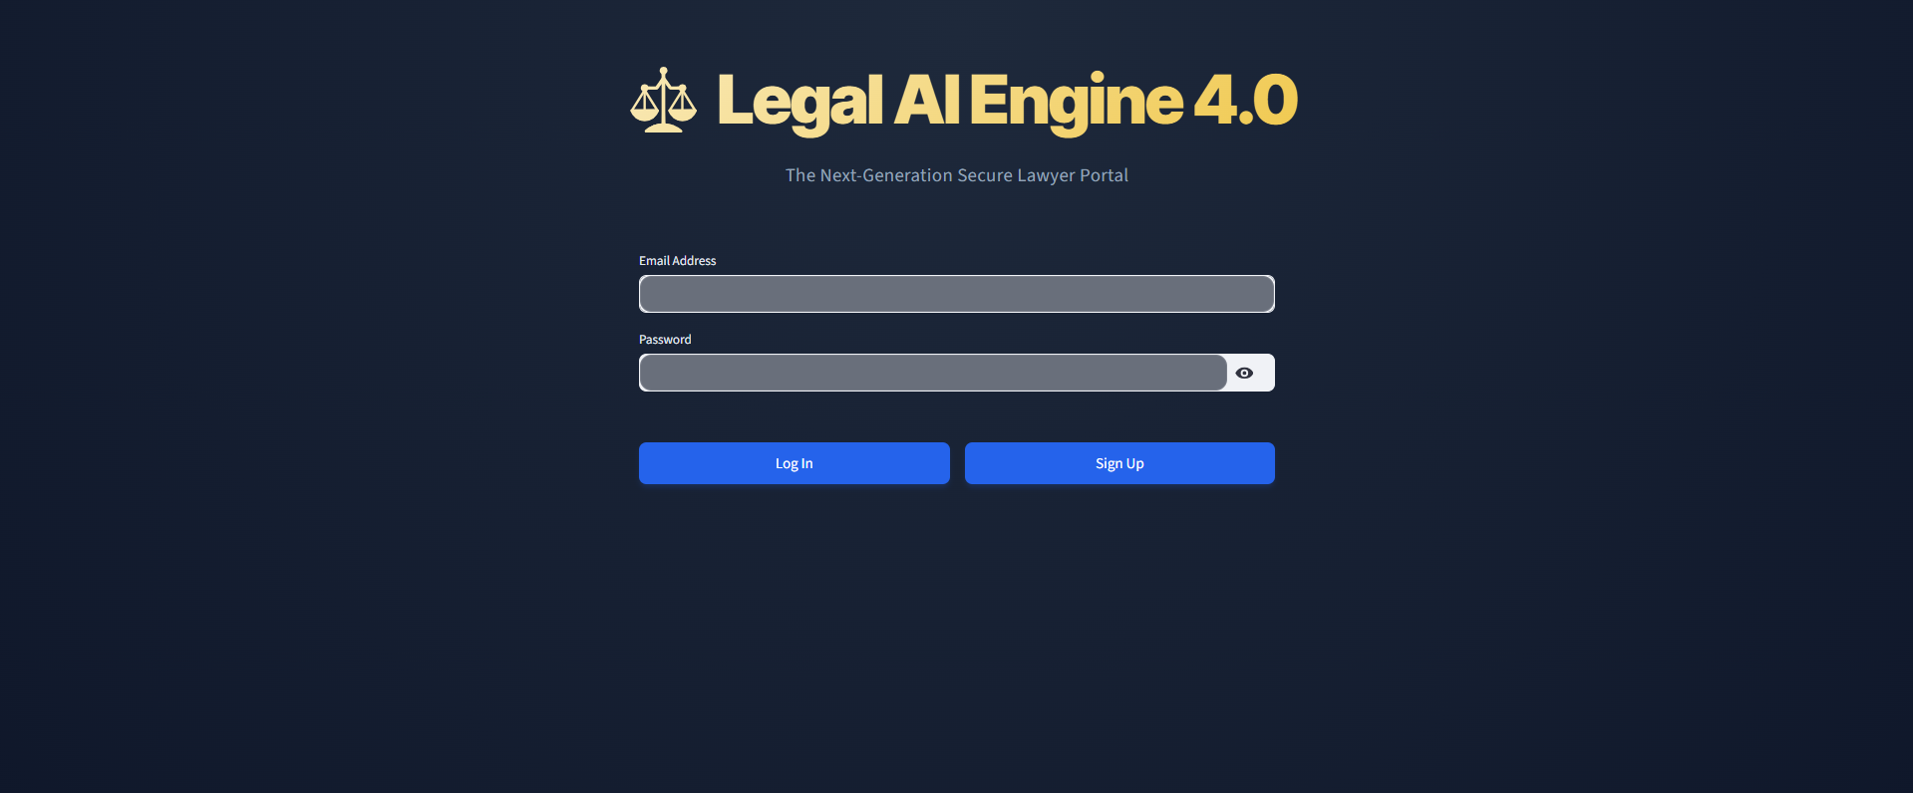
Nutan Maharashtra Vidya Prasarak Mandal’s NUTAN COLLEGE OF ENGINEERING AND RESEARCH Under Administrative Support of Pimpri Chinchwad Education Trust ISO 21001:2018 EOMS Certified
Review - IV
Implementation of Work / Result

Slide 12
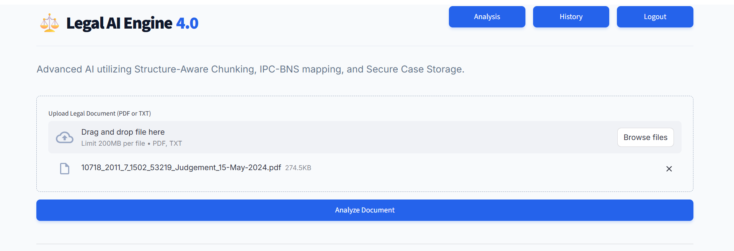
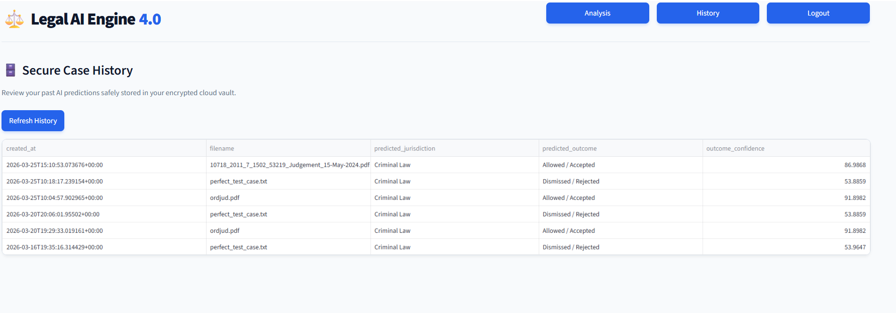
Nutan Maharashtra Vidya Prasarak Mandal’s NUTAN COLLEGE OF ENGINEERING AND RESEARCH Under Administrative Support of Pimpri Chinchwad Education Trust ISO 21001:2018 EOMS Certified
Review - IV
Implementation of Work / Result

Slide 13
Nutan Maharashtra Vidya Prasarak Mandal’s NUTAN COLLEGE OF ENGINEERING AND RESEARCH Under Administrative Support of Pimpri Chinchwad Education Trust ISO 21001:2018 EOMS Certified
Review - IV
Conclusion
We successfully engineered a production-ready Legal AI platform capable of parsing unstructured PDFs, dynamically updating historical laws (IPC to BNS), and predicting appellate outcomes with 85.2% accuracy.
By integrating NER-filtered Explainable AI (SHAP) and deploying it on a secure cloud architecture, we transformed a theoretical deep learning model into a practical, highly transparent decision-support tool for Indian lawyers.

Slide 14
Nutan Maharashtra Vidya Prasarak Mandal’s NUTAN COLLEGE OF ENGINEERING AND RESEARCH Under Administrative Support of Pimpri Chinchwad Education Trust ISO 21001:2018 EOMS Certified
Review - IV
Future Scope
Generative AI Integration: Implementing Large Language Models (LLMs) to automatically generate plain-English summaries of complex judgments alongside the predictions.
Regional Expansion: Expanding our JSON mapping dictionaries to include regional state laws and multilingual High Court translations (Marathi, Hindi).
Frontend Migration: Rebuilding the Streamlit UI in React.js or Next.js to provide a seamless, native mobile application experience for practicing lawyers on the go.

Slide 15
Nutan Maharashtra Vidya Prasarak Mandal’s NUTAN COLLEGE OF ENGINEERING AND RESEARCH Under Administrative Support of Pimpri Chinchwad Education Trust ISO 21001:2018 EOMS Certified
Review - IV
References
[1] Chalkidis, I., Fergadiotis, M., Malakasiotis, P., Hamel, J., & Androutsopoulos, I. (2020). LEGAL-BERT: “Preparing the Muppets for Court”. In Findings of the Association for Computational Linguistics: EMNLP 2020, pages 2598–2612, Online. Association for Computational Linguistics.
[2] Cao, L., Wang, Z., Xiao, C., & Sun, J. (2024). PILOT: Legal Case Outcome Prediction with Case Law. In Proceedings of the 2024 Conference of the North American Chapter of the Association for Computational Linguistics: Human Language Technologies (Volume 1: Long Papers), pages 609–621, Mexico City, Mexico. Association for Computational
Linguistics.
[3] Sharma, S., Shandilya, R., & Sharma, S. (2021). Predicting Indian Supreme Court Judgments, Decisions, Or Appeals. arXiv preprint arXiv:2110.09251.
[4] Alghazzawi, D., Alghamdi, R., Alotaibi, A., & El-Din, A. M. B. (2022). Efficient Prediction of Court Judgments Using an LSTM+CNN Neural Network Model with an Optimal Feature Set. Mathematics, 10(5), 683.
[5] Schafer, B., Middelton, C., & Schafer, R. (2023). Explainable AI and Law: An Evidential Survey. Artificial Intelligence and Law, 31(4), 589-623.

Slide 16
Nutan Maharashtra Vidya Prasarak Mandal’s NUTAN COLLEGE OF ENGINEERING AND RESEARCH Under Administrative Support of Pimpri Chinchwad Education Trust ISO 21001:2018 EOMS Certified
Review - IV
References
[6] Malik, V., Sanjay, R., Nigam, S. K., Ghosh, K., Guha, A. K., Bhattacharya, A., & Modi, A. (2021). ILDC for CJPE: Indian Legal Documents Corpus for Court Judgment Prediction and Explanation. In Proceedings of the 59th Annual Meeting of the Association for Computational Linguistics (ACL), pages 4046–4062.
[7] Nigam, S. K., Kumar, A., & Bhattacharya, A. (2024). NyayaAnumana & INLegalLlama: The Largest Indian Legal Judgment Prediction Dataset. arXiv preprint arXiv:2412.08385.
[8] Sahoo, S., Pattnaik, M., & Das, A. (2023). A Comprehensive Analysis of Indian Legal Documents Summarization Techniques. Neural Computing and Applications, 35(21), 14611–14631.
[9] Katz, D. M., Bommarito, M. J., & Blackman, J. (2017). A General Approach for Predicting the Behavior of the Supreme Court of the United States. PLOS ONE, 12(4), e0174185.
[10] Liu, Y., Zhang, W., Zhang, M., Ding, X., & Fan, X. (2022). Legal Text Recognition Using LSTM-CRF Deep Learning Model. Computational Intelligence and Neuroscience, 2022, 1–10.
[11] Savelka, J., & Ashley, K. (2023). Leveraging Large Language Models for Legal Text Prediction. Artificial Intelligence and Law, 32(1), 1-25.
[12] Ashley, K. D. (2017). Artificial Intelligence and Legal Analytics: New Tools for Law Practice in the Digital Age. Cambridge University Press.

